Slide 1

Long Run Effective Demand
Introducing Residential Investment in a Sraffian Supermultiplier Stock-Flow Consistent Model
Gabriel Petrini
Lucas Teixeira
University of Campinas
(Unicamp)
46th Conference of the Forum for Eastern Economic Association (EEA)

Slide 2
Summary
1. Empirical motivation
2. Review of the literature: demand-led growth
3. Stock-Flow Consistent Sraffian Supermutiplier model
How to include residential investment in a heterodox growth model?

Slide 3
Empirical Literature
Non-capacity creating autonomous expenditures
Freitas and Dweck (2013)
Braga (2018)
Girardi and Pariboni (2016, 2018)
Residential Investment
Green (1997)
Leamer (2007)
Fiebiger (2018)

Slide 4
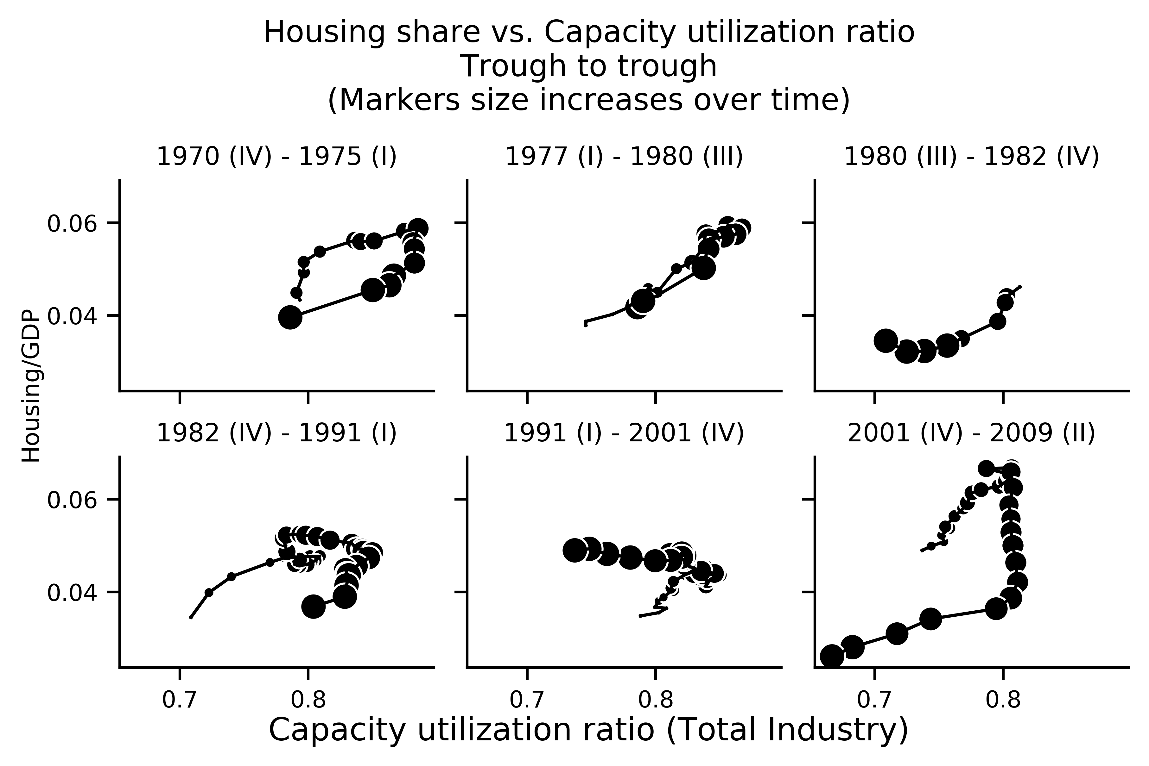
Empirical motivation: U.S. Economy

Slide 5
Literature Review: Alternative Closures
Harrod`s question: which are the conditions for a balanced growth between demand and supply?
Heterodox alternative closures:
Cambridge
Kalecki
Sraffian Supermultiplier

Slide 6
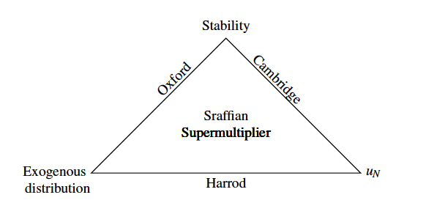
Literature Review: Alternative Closures
Authors` elaboration

Slide 7
Literature Review: autonomous expenditures
Hybrid neo-Kaleckian models:
Allain (2015): public expenditures
Nah and Lavoie (2017): exports
Sraffian Supermultiplier:
Pariboni (2016), Mandarino, dos Santos and Macedo e Silva (ROKE, forthcoming): debt-financed consumption
Brochier and Macedo e Silva (2019): fully specified SSM-SFC; wealth-financed consumption

Slide 8
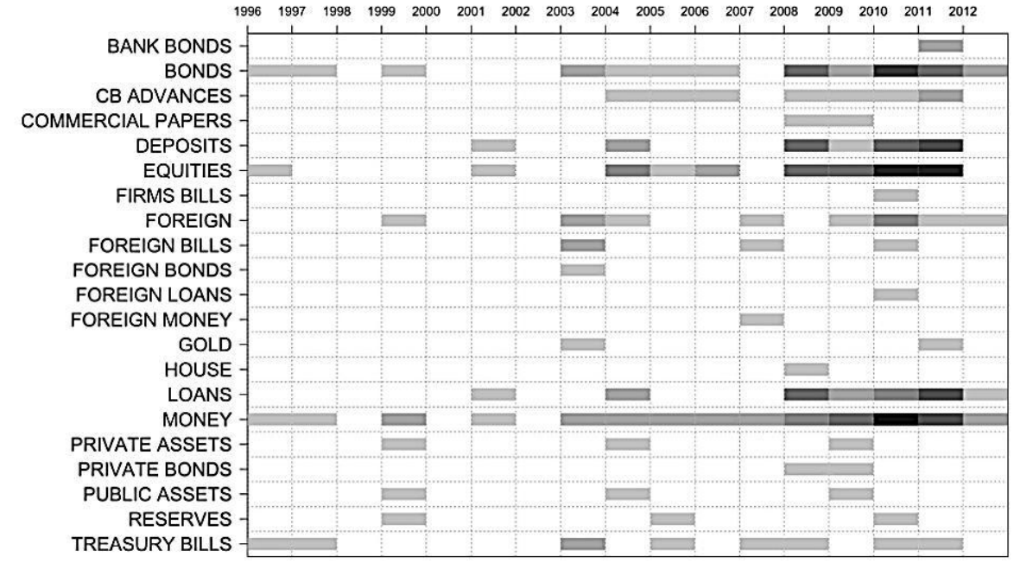
Houses in SFC Approach
Source: Caverzasi and Godin (2015)

Slide 9
SSM-SFC with Residential Investment

Slide 10
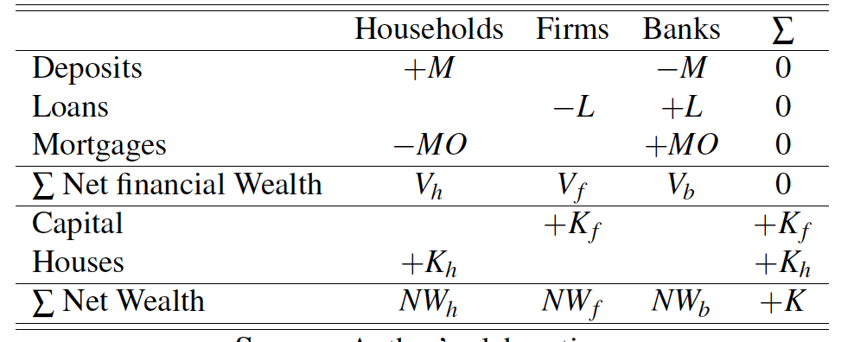
Balance Sheet Matrix

Slide 11
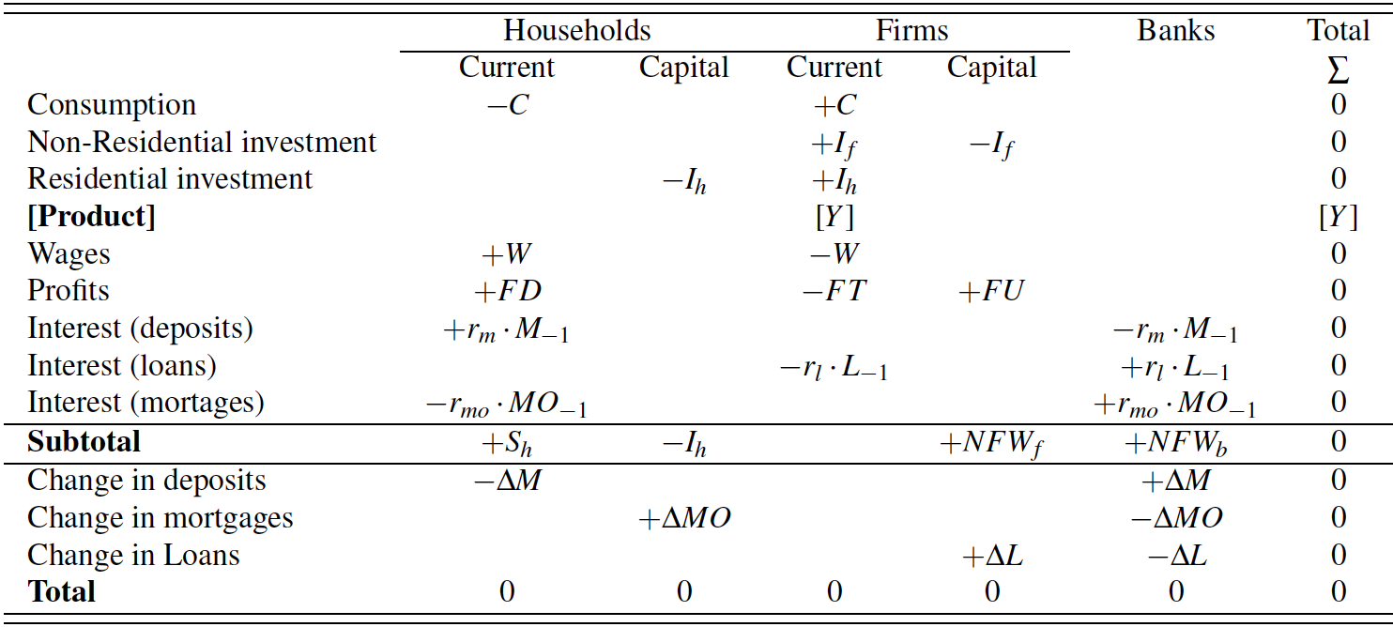
Transaction Flow Matrix and Flow of Funds

Slide 12
Model Strutcture
Leontief production function
Output determination
Y = C + I_{h} + I_{f}
Firms investment
I_{f} = hY
Δh = h₋₁γ (u – u_{n})

Slide 13
Main Equations
Household Expenditures
Induced Consumption
C = ωY
Autonomous residential investment
I_{h} = Z = (1+g_{z})I_{h-1}
ΔMO = I_{h}

Slide 14
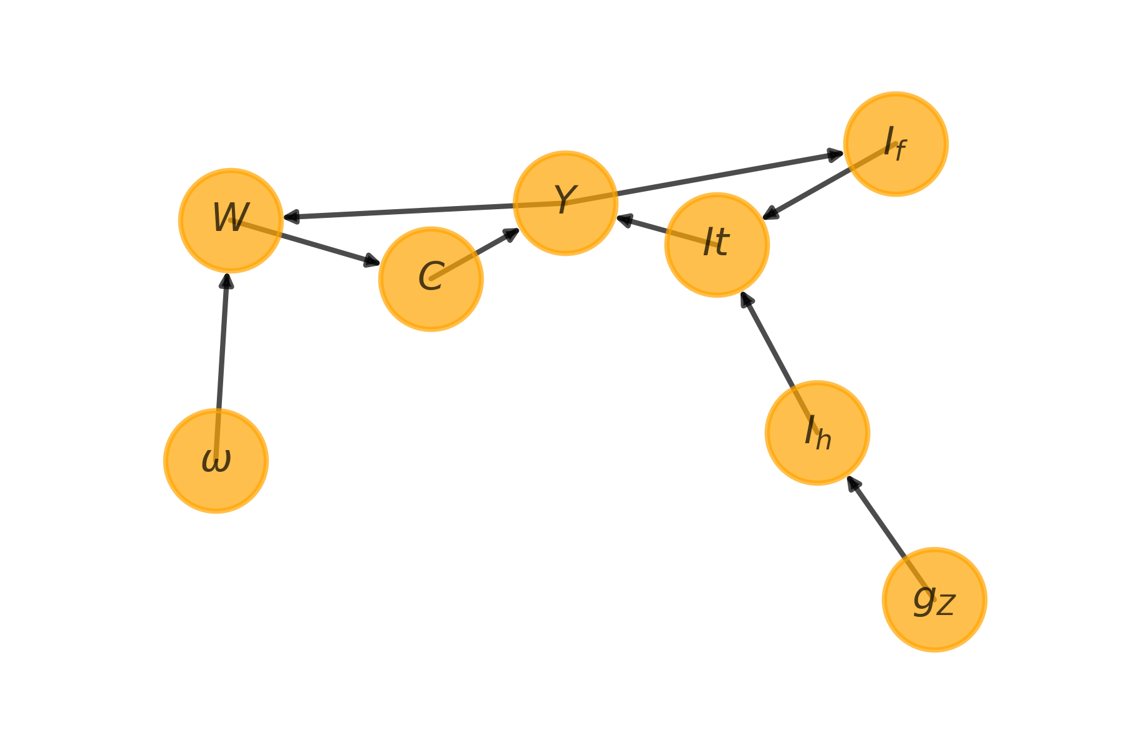
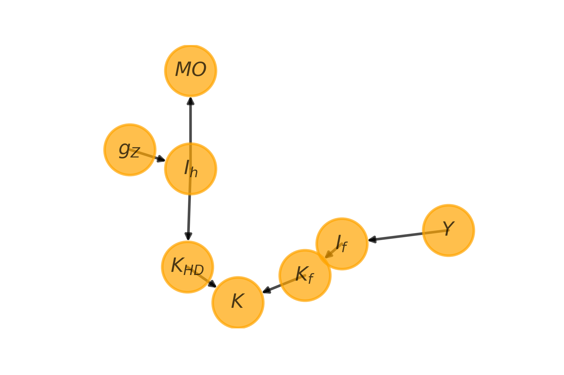
Model Graphs
Flows dynamics
Stocks-Flows dynamics

Slide 15
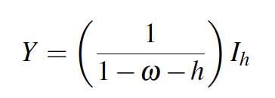
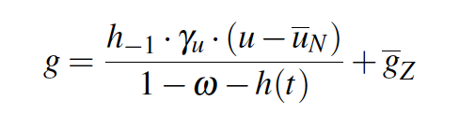

Model Solution
Outuput level
Out of equilibrium growth rate
Equilibrium growth rate

Slide 16


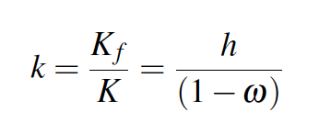
Model Solution
Firms investment share
Two types of real assets
Share of firms capital on total capital

Slide 17
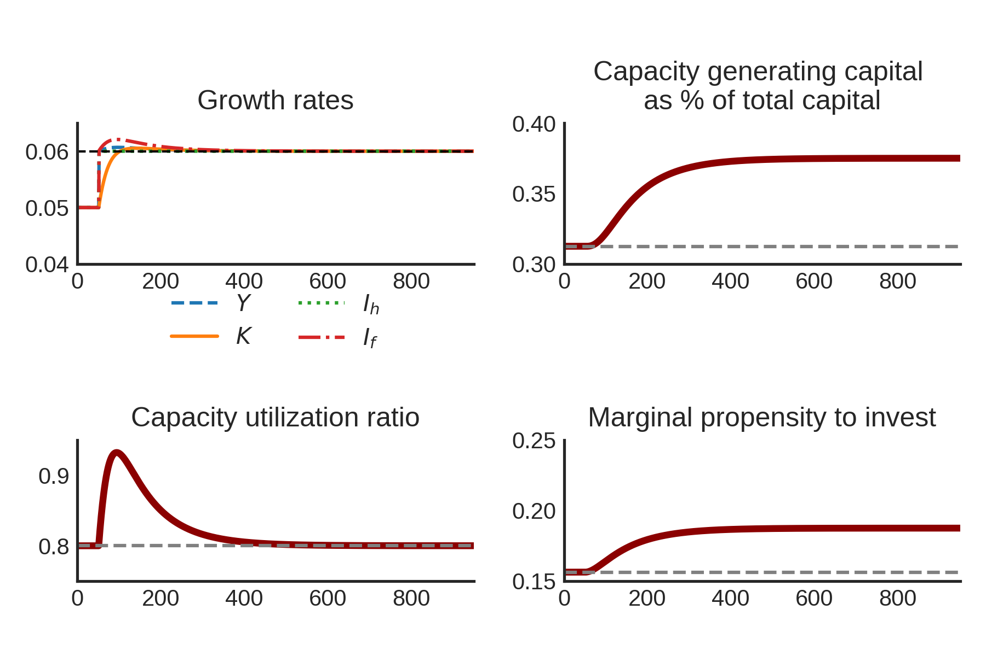
Numerical Simulations: increase of g_{z}

Slide 18
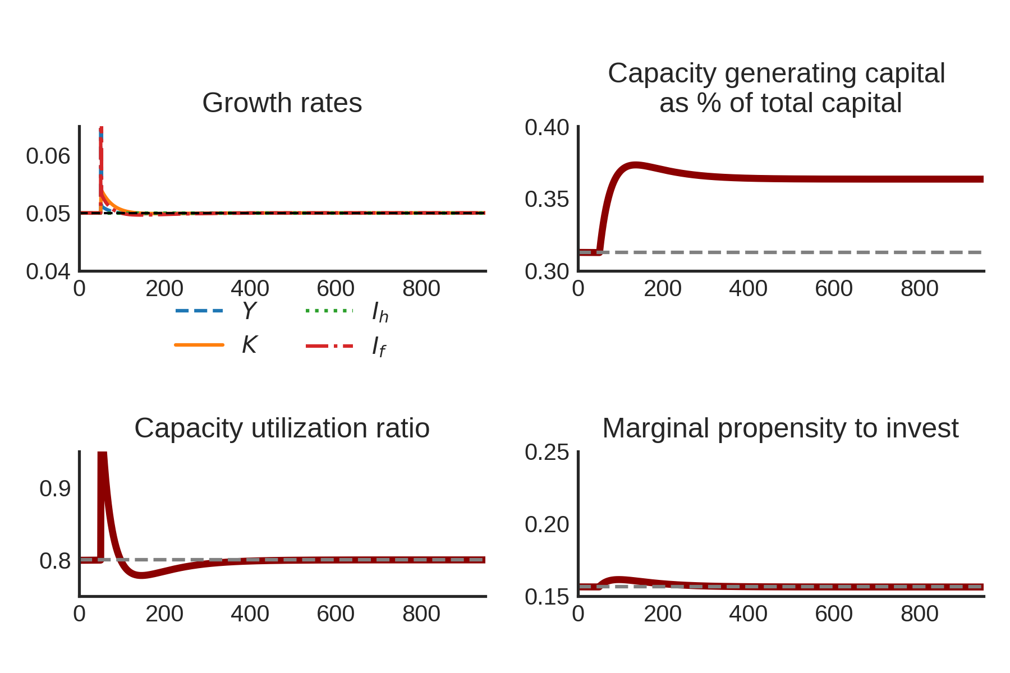
Numerical Simulations: increase of ω

Slide 19
Final Remarks
Our model preserves Sraffian Supermultipier main results
Increase of the wage-share does not increase long run growth rate
No paradox of cost
A greater growth rate of residential investment reduces houses share of total capital
Further research: to investigate the determinants of residential investment

Slide 20
Thank You Muito Obrigado

